Slide 1
Java Server Faces
overview

Slide 2
What is JSF?
JSF is a MVC web framework that simplifies the construction of user interfaces (UI) for server-based applications by using reusable UI components in a page.
Benefits
providing reusable UI components
making easy data transfer between UI components
managing UI state across multiple server requests
enabling implementation of custom components
wiring client side event to server side application code

Slide 3
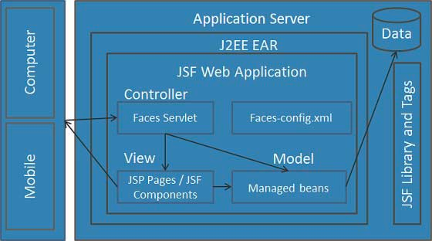
JSF Architecture

Slide 4
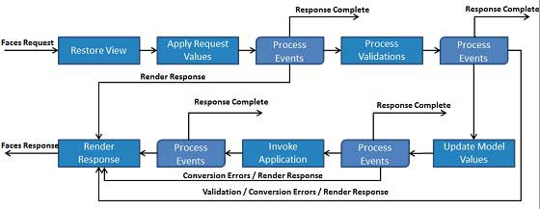
JSF - Life Cycle

Slide 5
Managed Beans
Managed Bean is a regular Java Bean class registered with JSF. In other words, Managed Beans is a java bean managed by JSF framework.
The managed bean contains the getter and setter methods, business logic or even a backing bean (a bean contains all the HTML form value).
Managed beans works as Model for UI component.
Managed Bean can be accessed from JSF page.

Slide 6
Managed Beans
Scope Annotations
NoneScoped
RequestScoped
ViewScoped
SessionScoped
ApplicationScoped
CustomScoped

Slide 7
Basic Tags
h:inputText | h:outputFormat
h:inputSecret | h:graphicImage
h:inputTextarea | h:outputStylesheet
h:inputHidden | h:outputScript
h:selectBooleanCheckbox | h:commandButton
h:selectManyCheckbox | h:panelGrid
h:selectOneRadio | h:commandLink
h:selectOneListbox | h:outputLink
h:selectManyListbox | h:message
h:selectOneMenu | h:messages
h:outputText

Slide 8
Convertor Tags
JSF provides inbuilt convertors to convert its UI component's data to object used in a managed bean and vice versa. For example, these tags can convert a text into date object and can validate the format of input as well.

Slide 9
Validator Tags
JSF provides in built validators to validate its UI components. These tags can validates length of field, type of input which can be a custom object.

Slide 10
Composite Components
JSF provides developer a powerful capability to define own custom components which can be used to render custom contents.

Slide 11
Ajax
AJAX stands for Asynchronous JavaScript And Xml.
Ajax is a technique to use HTTPXMLObject of JavaScript to send data to server and receive data from server asynchronously.
So using Ajax technique, javascript code exchanges data with server, updates parts of web page without reloading the whole page.

Slide 12
Event Handling
When a user clicks a JSF button or link or changes any value in text field, JSF UI component fires event which will be handled by the the application code.
To handle such event, event handler are to be registered in the application code or managed bean.
When a UI component checks that a user event has happened, it creates an instance of the corresponding event class and adds it to an event list.
Then, Component fires the event, i.e., checks the list of listeners for that event and call the event notification method on each listener or handler.
JSF also provide system level event handlers which can be used to do some tasks when application starts or is stopping.

